Slide 1
LECTURE: 6
Search Strategies

Slide 2
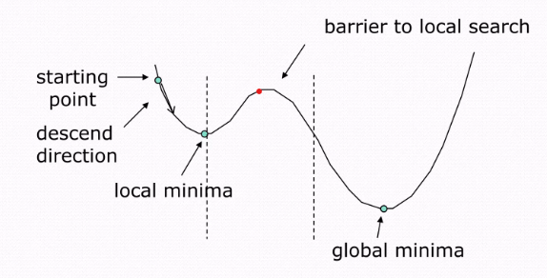
Simulated Annealing
Optimization inspired by metallurgical annealing.
Explores solution space probabilistically.
Gradually reduces temperature for convergence.
Handles complex combinatorial optimization problems.
Balances exploration and exploitation efficiently.
Eg: Scheduling flights, deliveries, work shifts

Slide 3
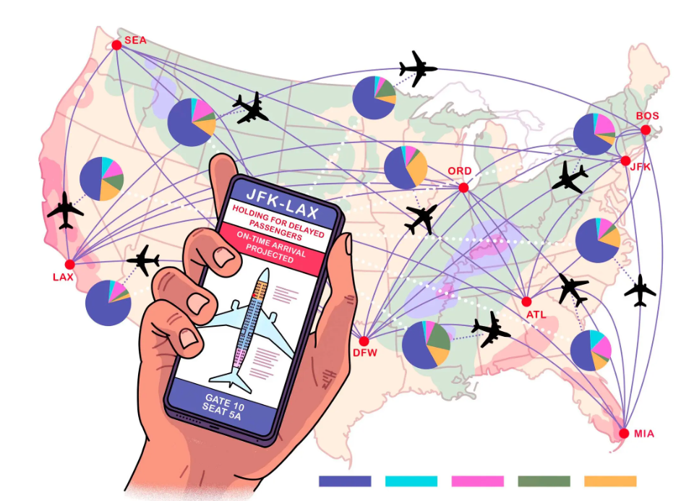
Algorithm for Simulated Annealing
Initialize temperature, solution, and parameters.
Generate a random neighbor solution.
Calculate the cost difference (ΔE).
Accept worse solutions probabilistically using ΔE.
Decrease temperature gradually (cooling schedule).
Repeat until stopping condition met.

Slide 4
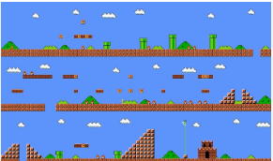
Best First Search
Best First Search uses heuristics.
It evaluates paths using priorities.
Finds shortest path in complex mazes.
Uses Open and Closed node lists.
Chooses best node for traversal.
Eg: Video games like Mario.

Slide 5
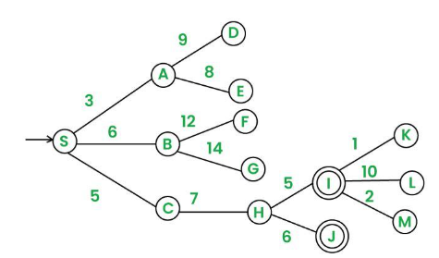
Algorithm for Best First Search
Initialize open list with start node.
While open list is not empty:
Remove node with lowest cost.
If node is goal, return path.
Expand node, add neighbors to list.
Sort list by heuristic or cost.

Slide 6
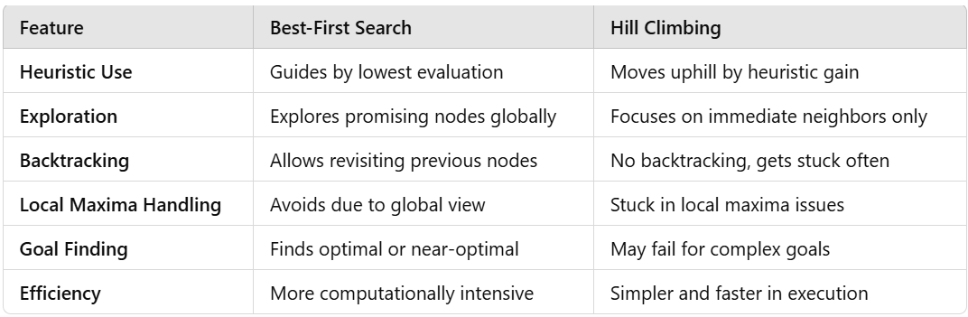
Best First Search VS Hill Climbing

Slide 7
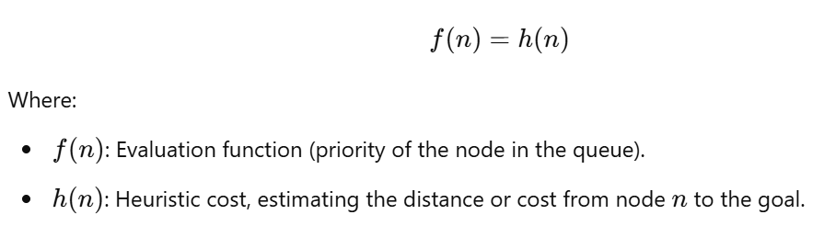
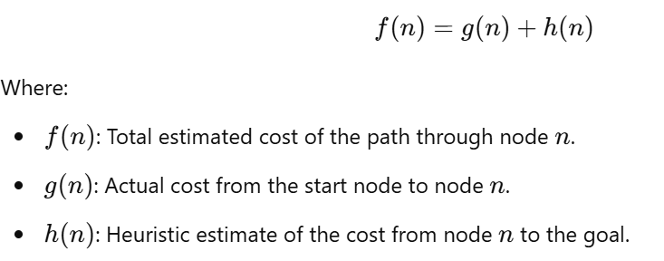
Types of Best First Search
Greedy Best-First Search (GBFS):
- Selects node closest to goal.
- Uses heuristic to prioritize nodes.
2. A* Search:
- Combines actual cost and heuristic.
- Finds optimal path efficiently using evaluation.

Slide 8

Greedy Best-First Search (GBFS)
Selects node appearing closest to goal.
Uses heuristic function for prioritization
Doesn't consider cost from start node.
May find suboptimal solutions quickly
Focuses solely on estimated goal distance.
Eg: Navigation, robotics, gaming

Slide 9
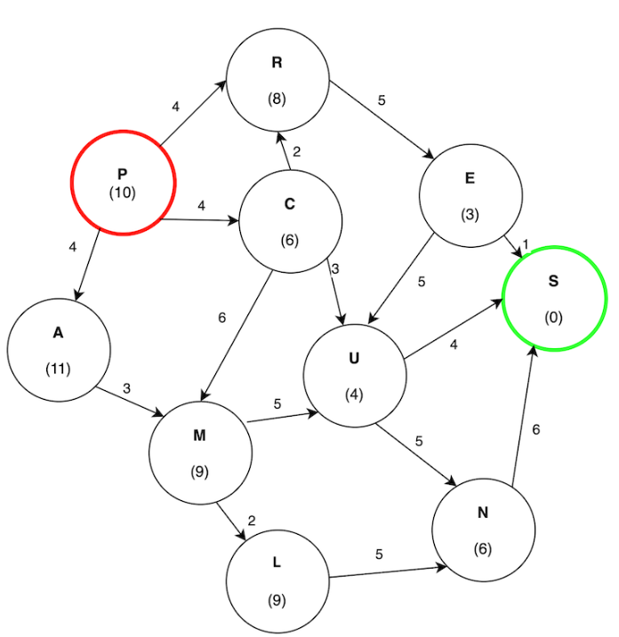
Working of Greedy Best-First Search (GBFS)
Initialize tree with root node.
Add start node to open list.
If open list empty, return failure.
Remove node with lowest h(n)
If node is target, return success.
Else, add unexplored children to list.

Slide 10
NEXT: Explore A*, CSP types, applications, and uses.

